Slide 1

Name= Atul Maurya.
Class = Btech (CSE) Section = “N”
Class Roll no: = 21
University Roll no: =2118371
Sem : =3rd ( 2nd year)
Student Id := 21011849

Slide 2



USING->

Slide 3
Content:
What is the Concept of Bus Status?
What is Django?
The knowledge that help in Making the project
Models
Admin
Views
Urls
Different typesCommands:- ( makemigration , migrate …etc)

Slide 4

LET’S TAKE A RIDE TO THIS PRESENTATION ☺

Slide 5

What is the Concept of Bus Status?
The Bus Status Project is based on Web based Projects By using Django, HTML and CSS .
I got the idea to built this project because I saw that the Student Of our University Facing issues in the college for finding their buses that which bus number will go to their destination and When .

Slide 6

So , I thought that What if all can see their Bus Status on their Mobile phone Just by going to the website and Entering the Details that Where they want to go and the Time Then After Pressing the Search Button they Can get the details That Which Bus Number is ready to go to their desired location.
And the Bus Driver Who as a admin will registering the information about the bus details by login in the Website.

Slide 7

What is Django?
Django is a Python-based web framework that allows you to quickly create efficient web applications. It is also called batteries included framework because Django provides built-in features for everything including Django Admin Interface, default database – SQLlite3, etc.
Django gives you ready-made components to use and that too for rapid development.

Slide 8

The knowledge that help in Making the project:-
Basic knowledge of the Django framework :-
2. First-hand experience in web development
3. Proficiency in Python
4. An understanding of the MySQL and SQL databases
5. Efficient testing, debugging codes
6. Building complex websites with large data processing requirements
7. An understanding and basic knowledge of front-end development
8. Verification of code functionality.

Slide 9
Models
According to Django Models A model is the single, definitive source of information about your data.
It contains the essential fields and behaviors of the data you’re storing. Generally, each model maps to a single database table.
The basics:
Each model is a Python class that subclasses django.db.models.Model.
Each attribute of the model represents a database field.
With all of this, Django gives you an automatically-generated database-access API.
Django models are used as a structure to define fields and their types which will be saved in the database.
Whatever changes we want to make in the database and want to store them in the database permanently are done using Django Models. A table for a phone in the database

Slide 10
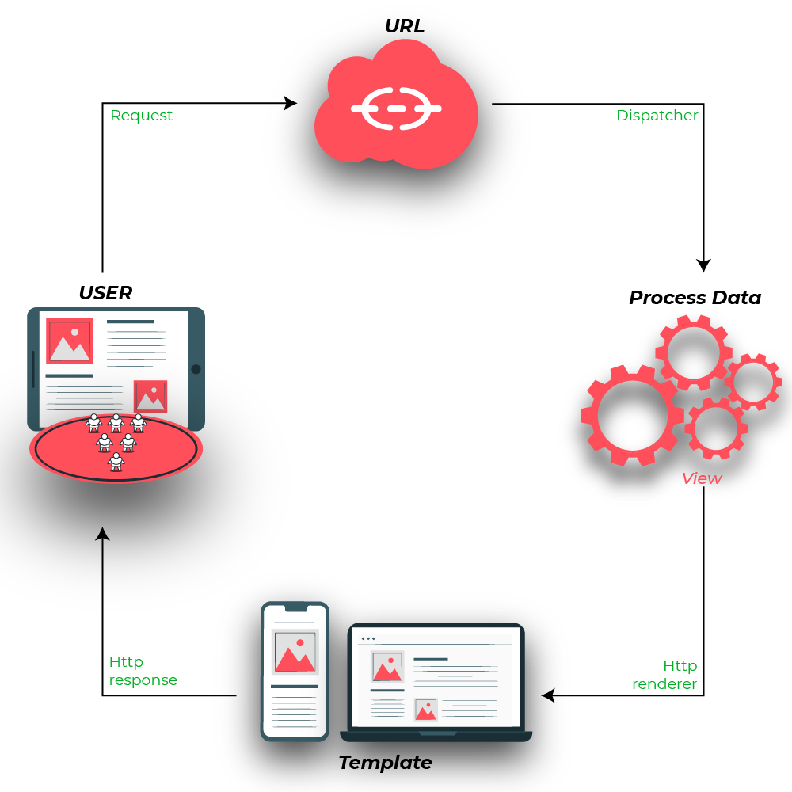
Views:-
There are two type of Views:-
Function based
Class Based
Django Views are one of the vital participants of MVT Structure of Django. As per Django Documentation, A view function is a Python function that takes a Web request and returns a Web response.
Django views are part of the user interface — they usually render the HTML/CSS/Javascript in your Template files into what you see in your browser when you render a web page.

Slide 11
Urls:-
A Django template is a text document or a Python string marked-up using the Django template language. Django being a powerful Batteries included framework provides convenience to rendering data in a template. Django templates not only allow passing data from view to template, but also provides some limited features of programming such as variables, for loops, comments, extends, url, etc.
{% url 'some-url-name' v1 v2 %}
The first argument is a URL pattern name. It can be a quoted literal or any other context variable. Additional arguments are optional and should be space-separated values that will be used as arguments in the URL
{% url 'template1' %}

Slide 12
Different typesCommands:-
* Install pip:-
python -m pip install -U pip
* Install Django-
pip install django
* Start a project by following command-
django-admin startproject Project
* Change directory to Project
cd Project
* Start the server:-
python manage.py runserver
* makemigrations:-
Python manage.py makemigrations
* migrate:-
Python manage.py migrate

Slide 13


